Slide 1
Crime Data and the Legalization of Marijuana.
Rose Gonoud
Robert McLauchlan
Spencer LaFarge
Harmony Mosby

Slide 2
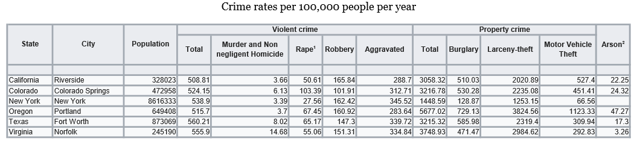
Overall Summary
What effect does a state’s legalization of marijuana have on crime rates?
We chose three cities from states that had legalized marijuana and three cities from states that had not. These cities all had similar standardized crime rates.
We hypothesized that marijuana legalization decreased both violent and non-violent crime rates. We pulled data from a multi-year FBI crime dataset to investigate.

Slide 3
Our Central Research Questions
Is there evidence of marijuana altering criminal behavior?
Have particular cities’ violent crime rates decreased after legalization?
Have particular cities’ non-violent crime rates decreased after legalization?
Do cities that have never had marijuana legalization efforts show dramatically different crime rates than marijuana-legalized cities within post-legalization years?
Our Cities and their Legalization Status:
Weed Legalized Weed Criminalized
Portland, Oregon New York, New York
Riverside, California Fort Worth, Texas
Colorado Springs, Colorado Norfolk, Virginia

Slide 4
Data Collection and Sourcing
To investigate changes in violent and non-violent crime over certain years:
Where applicable, we need to know the date of marijuana legalization.
We need yearly crime data for all of our cities for a wide range of years.
FBI data set
In all of our cities, at the time of the crime, how many individuals were under the influence of marijuana?
We were unable to find this data.
One could imagine a city with a higher crime rate but fewer individuals committing the crimes (more repeat offenders). Would our cities have any dramatically different numbers of repeat offenders?
If we are concerned with marijuana altering criminal behavior in individuals, unique criminal identities would be useful to have.
We were unable to find this data.

Slide 5
Data Cleanup and Exploration
See our first Jupyter notebook! (Initial Data Exploration).

Slide 6
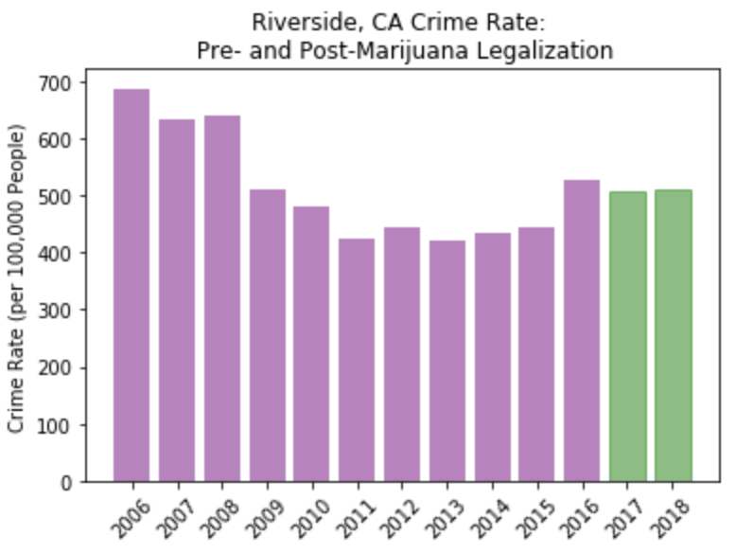
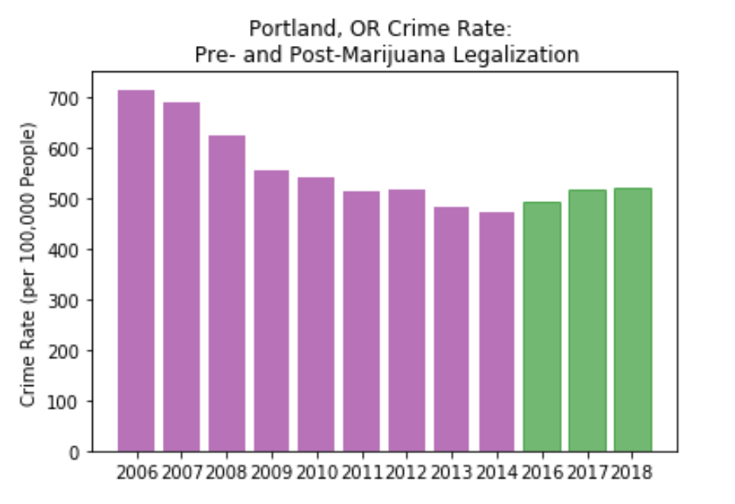
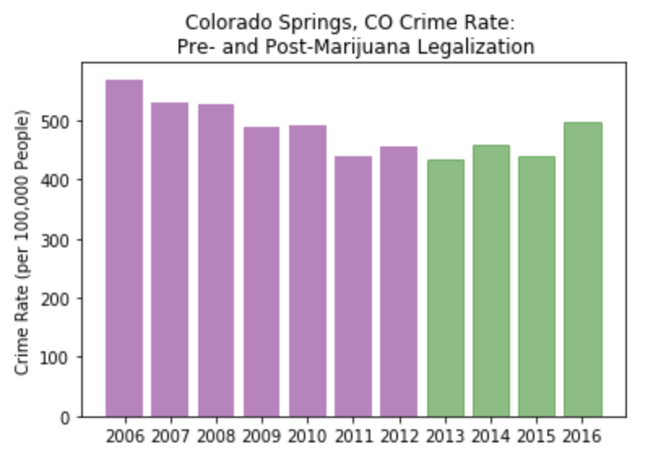
Initial Analysis
Data visualization began with basic bar plots representing aggregated violent crime rates pre- and post-legalization.

Slide 7
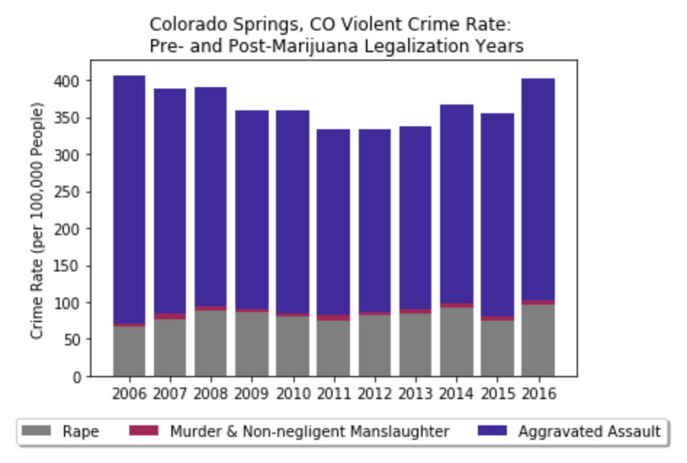
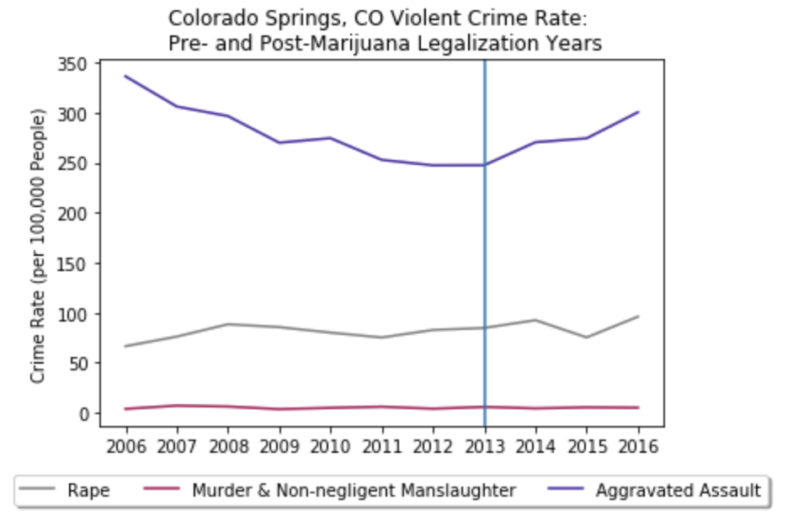
Colorado Springs, Colorado
Violent Crime, Marijuana Legalized December, 2012
Since the legalization of Marijuana in Colorado Springs, Colorado at the end of 2012
The data shows a slight increase in the violent crime rate per 100,000.

Slide 8
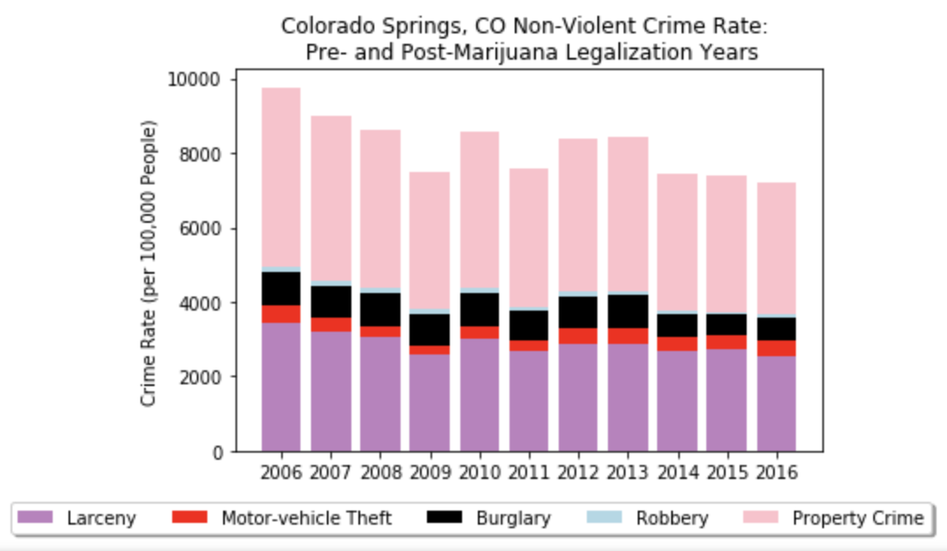
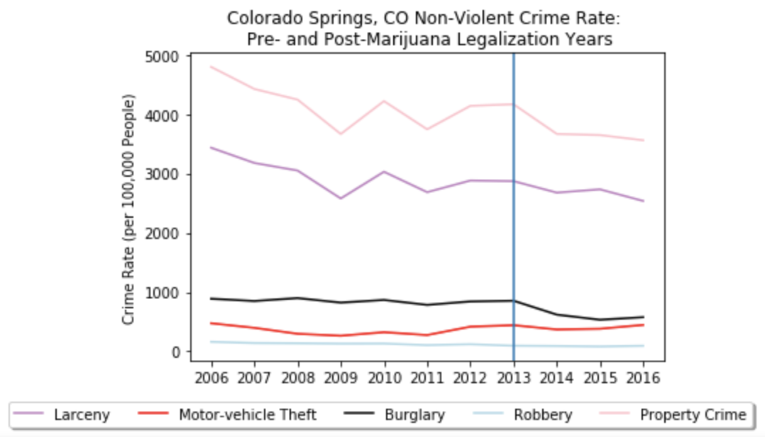
Colorado Springs, Colorado
Non-Violent Crime, Marijuana Legalized December, 2012
Since the legalization of Marijuana in Colorado Springs, Colorado at the end of 2012
The data shows the Non-Violent crime rate trending down per 100,000.

Slide 9
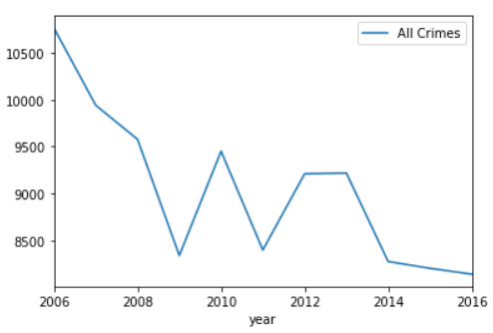
Colorado Springs, Colorado
Legalized Marijuana December, 2012
The overall crime rate (Violent and Non-Violent) since legalization in 2012 appears to be trending downward per 100,000.
To truly be able to see the trends of how Marijuana affects crime rate we needed to find data that showed at the time of the crime, how many individuals were under the influence of marijuana and we were unable to find the additional data.

Slide 10
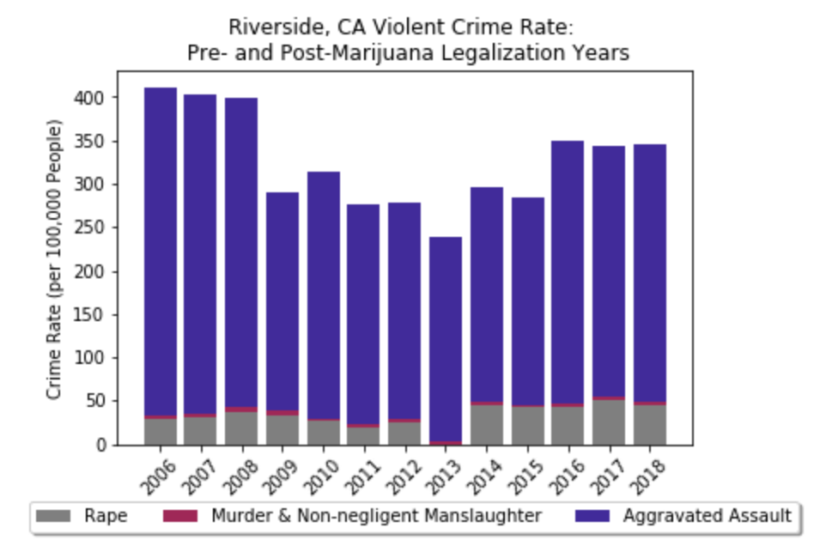
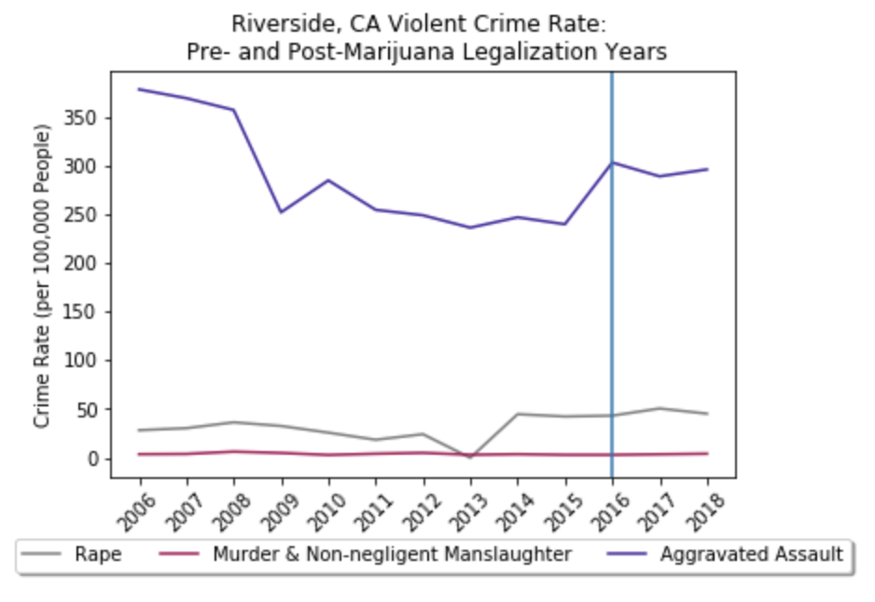
Riverside, California
Violent Crime, Marijuana Legalized in 2016
Violent Crime Rate has increased and stayed constant over three years since legalization.

Slide 11
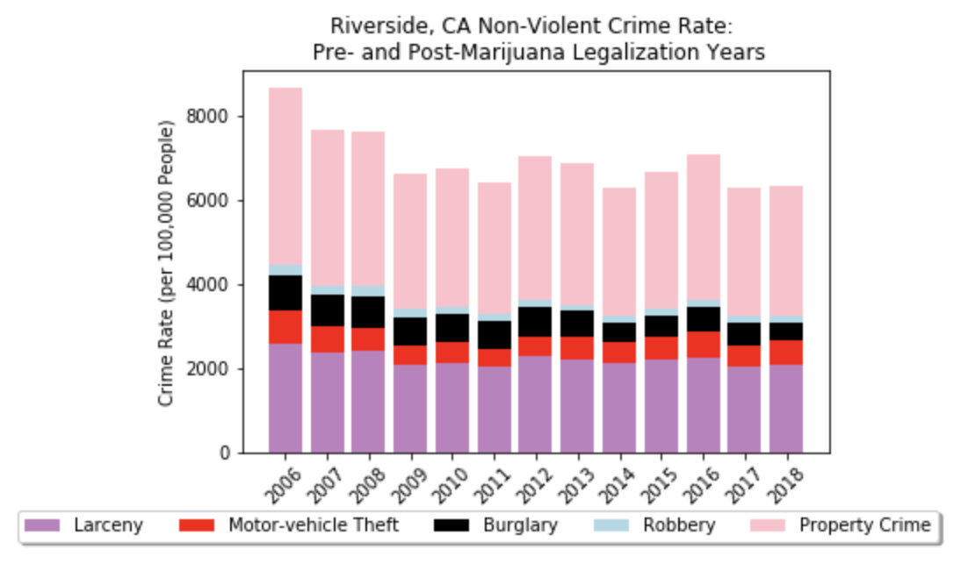
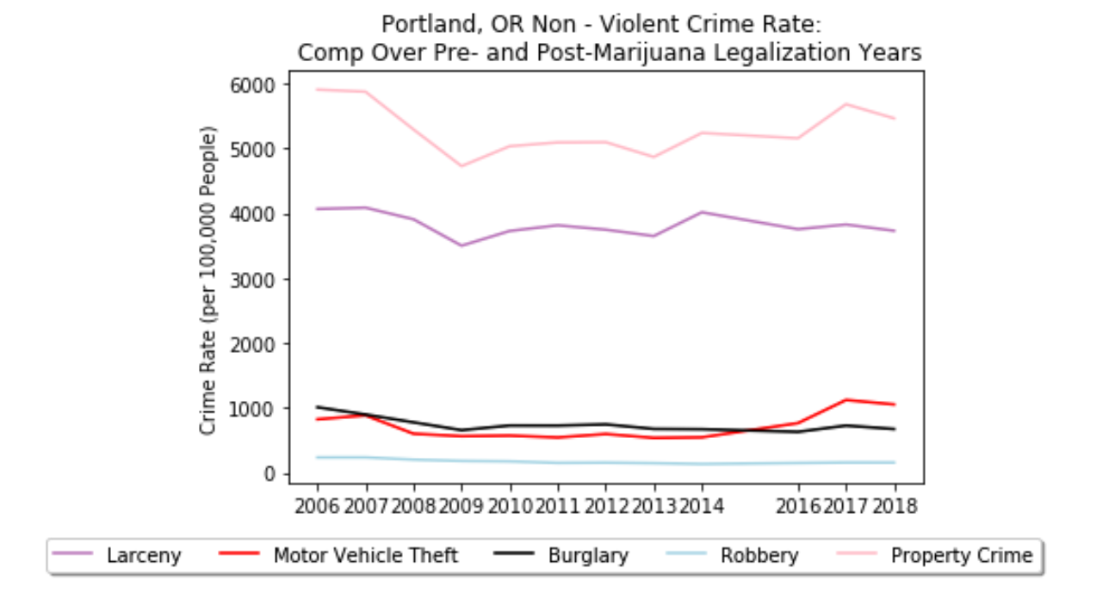
Riverside, California
Non-Violent Crime, Marijuana Legalized in 2016
Non-Violent Crime Rates decreased in 2017 and 2018 from the previous year.

Slide 12
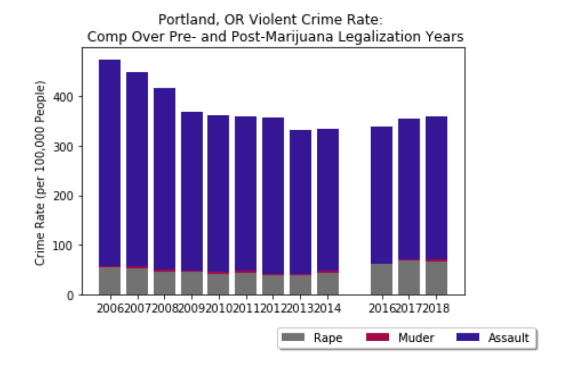
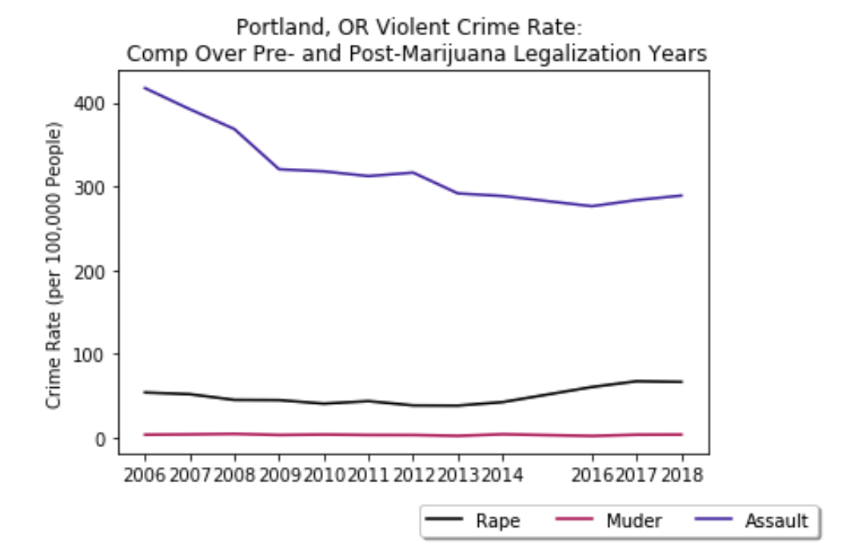
Portland, OR
(Violent Crime) Marijuana legalized 2016
Talking points
These two graphs show an uptrend in violent crime but specifically between assault and rape since 2016

Slide 13
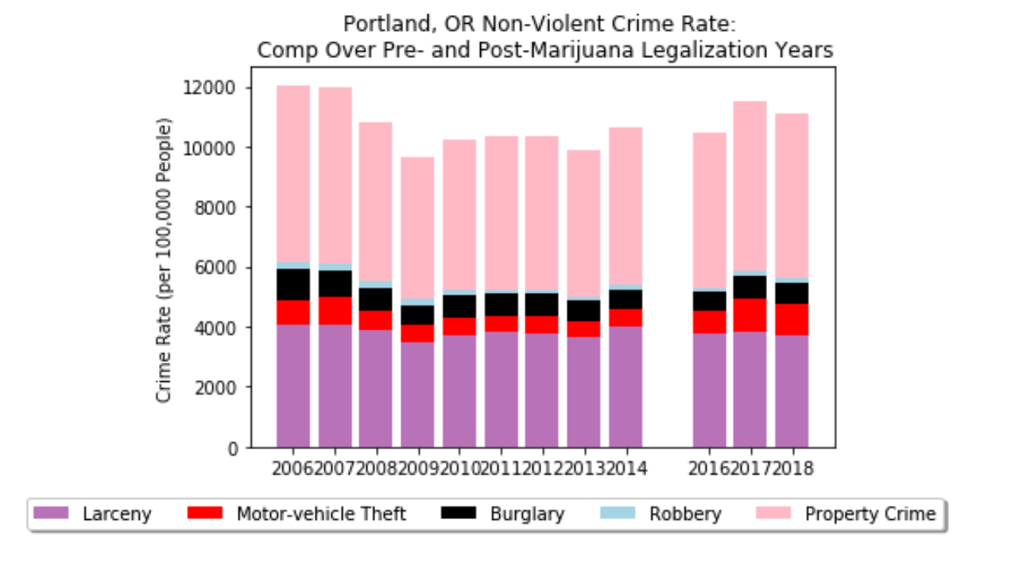
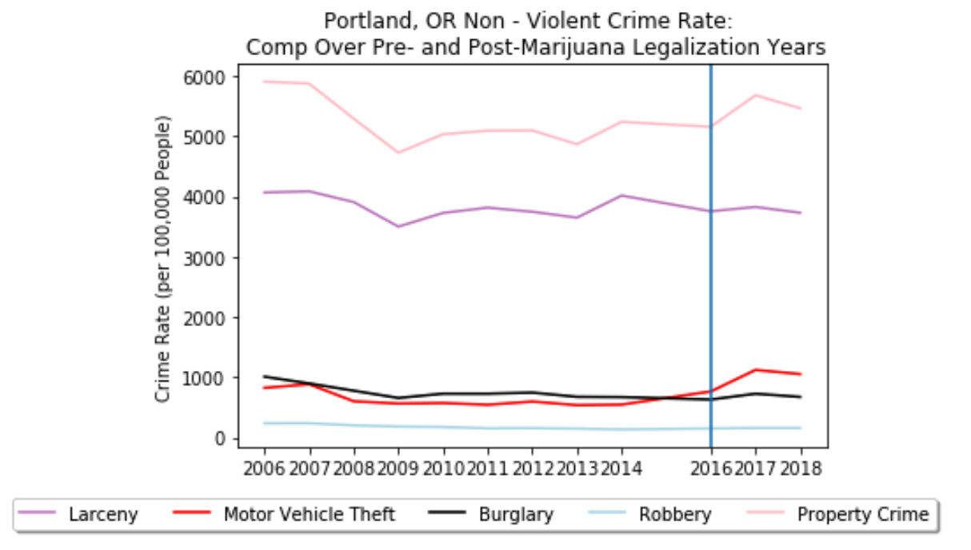
Portland, OR
(Non-Violent Crime) Marijuana legalized 2016
These two graphs also show an uptrend between property crime, motor vehicle theft, larceny, and burglary from previous years while robbery remains rather stagnant.

Slide 14
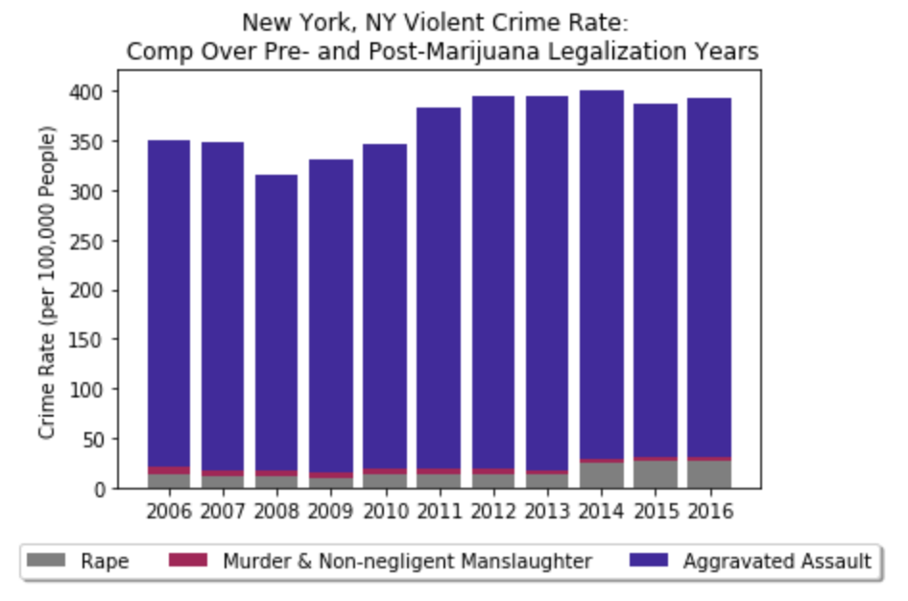
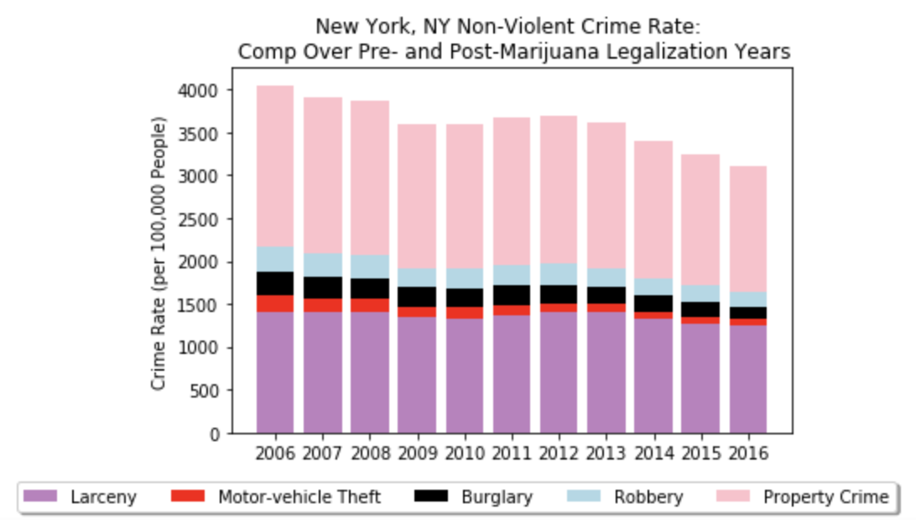
New York, New York
Marijuana still criminalized

Slide 15
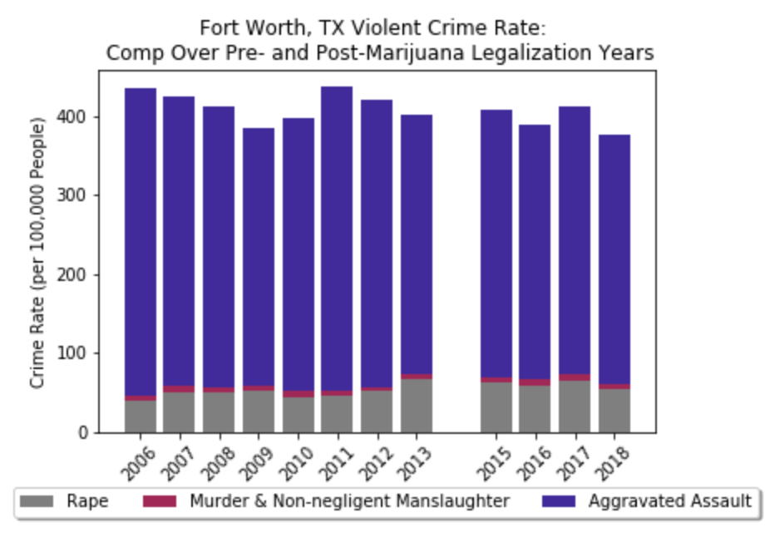
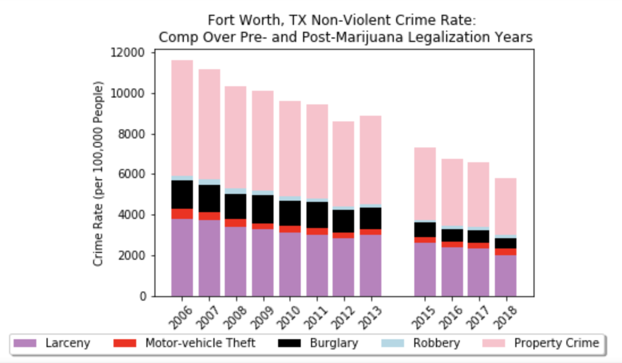
Fort Worth, Texas
Marijuana still criminalized
Seemingly no trend in violent crime rates.
Non-violent crime rates consistently dropping.
In order to show the effects of marijuana on crime we would need to have found a data set that included crime rates while under the influence.

Slide 16
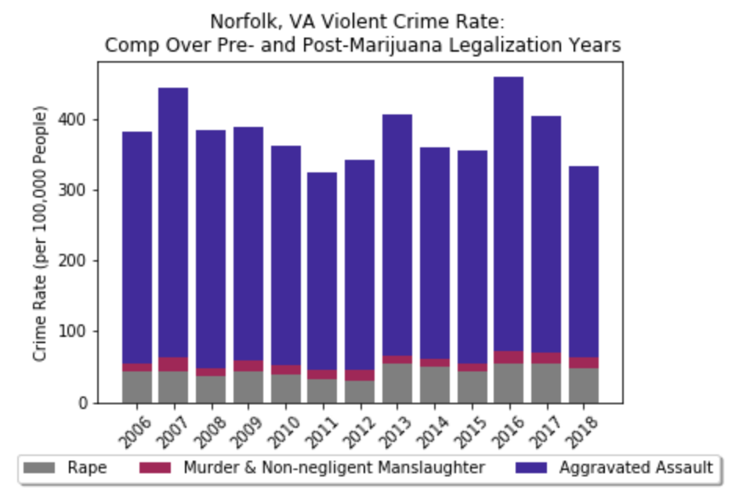
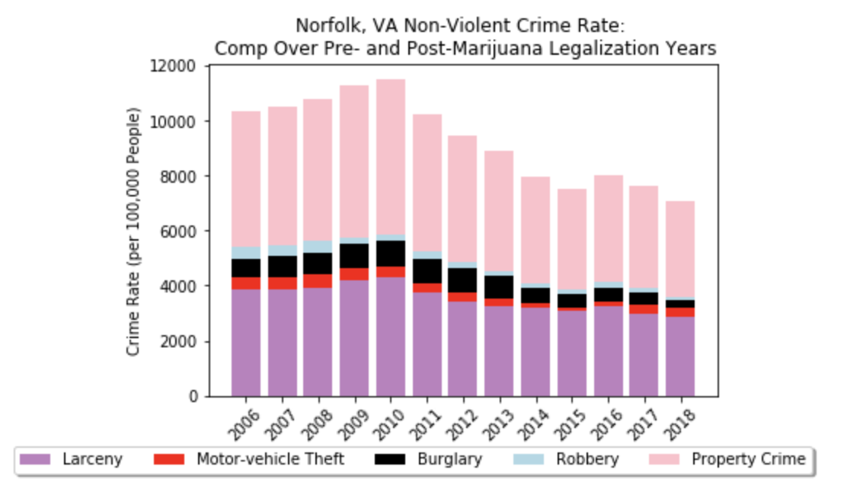
Norfolk, Virginia
Marijuana still criminalized

Slide 17
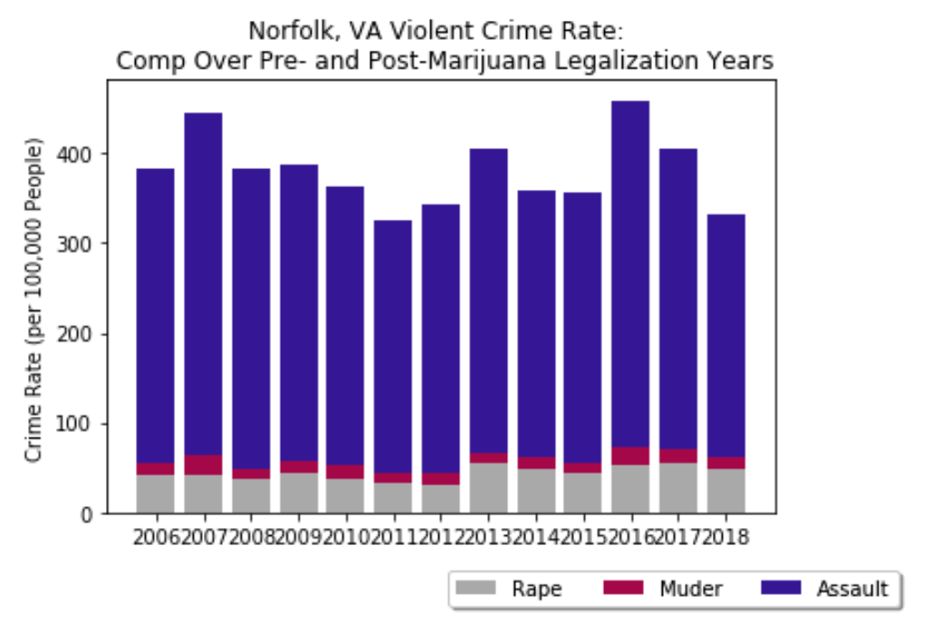
Violent Crime Overall

Slide 18
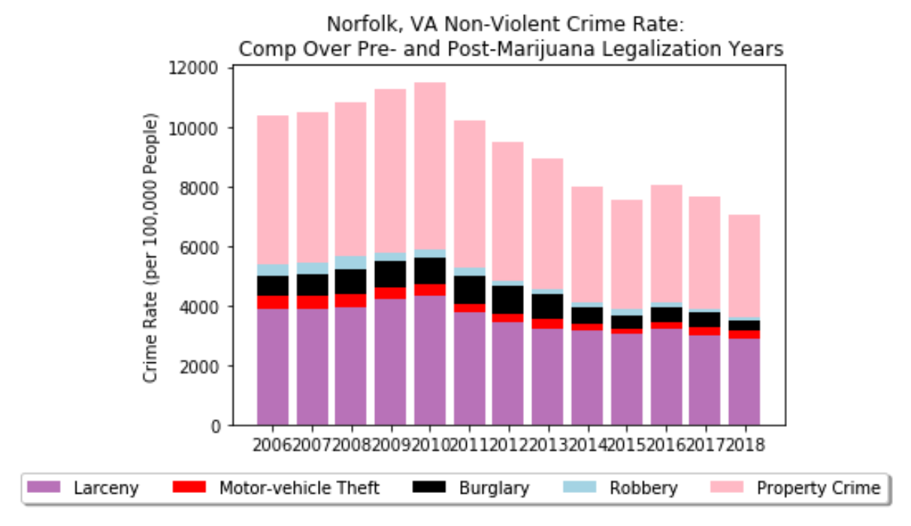
Non-Violent Crime Overall

Slide 19
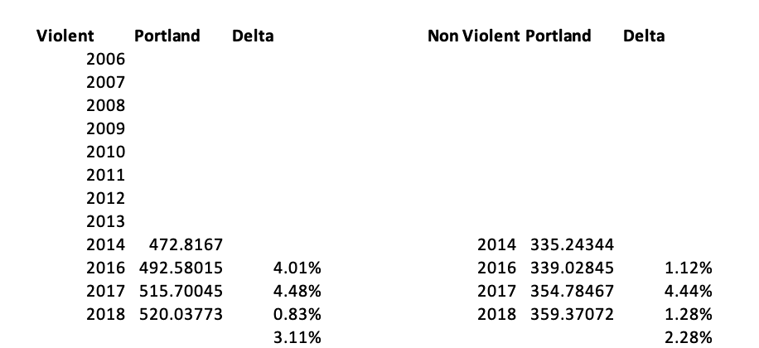
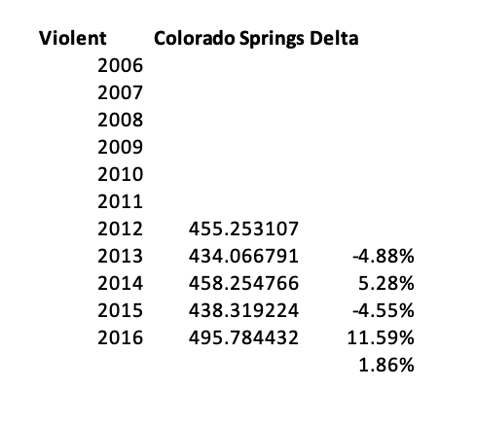
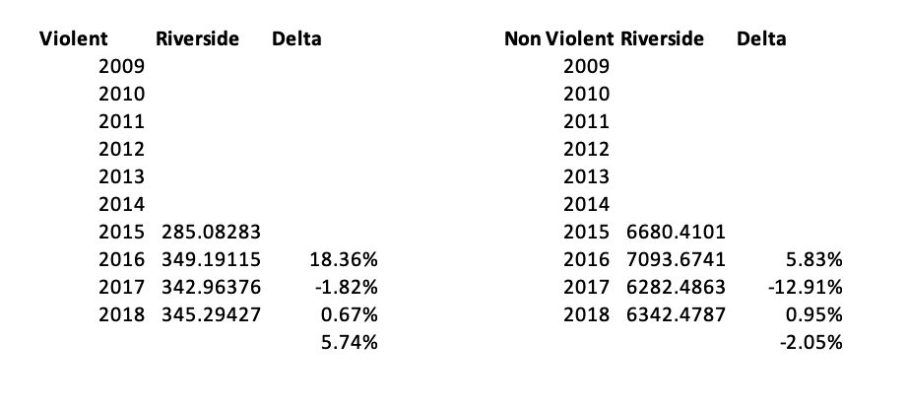
Year over Year Change in Percentage

Slide 20
Conclusions
Our initial hypothesis was that marijuana legalization would decrease both violent and non-violent crime rates.
Our Null Hypothesis was that marijuana legalization would not have an effect on violent and non-violent crime rates.
Ultimately, we found no correlation between marijuana legalization and crime rate per 100,000 as it pertains to our first question of “Is there evidence of marijuana altering criminal behavior?” To do so we needed an extra data set showing whether the commission of the crime happened while under the influence of Marijuana. Without that dataset we are unable to answer that question. Since we did not have enough data to corroborate either way, we therefore failed to reject our Null Hypothesis.
In regards to our other questions of whether violent crime and non-violent crime decreased or increased after legalization we found that yes in fact there was a correlation between legalization and crime per 100,000 as discussed in the previous slides and in the next Implications slide.

Slide 21
Implications
Portland, OR, Riverside, CA and Colorado Springs, CO all saw an increase in violent crime post-legalization. This is holding the assumption that marijuana was not consumed, but rather that when a city legalizes marijuana they should expect violent crime to increase.
With the exception of Portland, OR, non-violent crime decreased in Riverside, CA and Colorado Springs, CA

